Slide 1
Validation

Slide 2
Validation Data
4 Measured aruco trials for the corresponding validation path
Compare measured vs ground truth:
Step 1: Load 24-trial derived registration matrix ( aruco→ kuka)
Step 2: Transform all measured aruco points to kuka reference frame
Step 3: calculate path lengths (mm) for each sequential trajectory
Step 4: Get respective trajectory RMSE

Slide 3
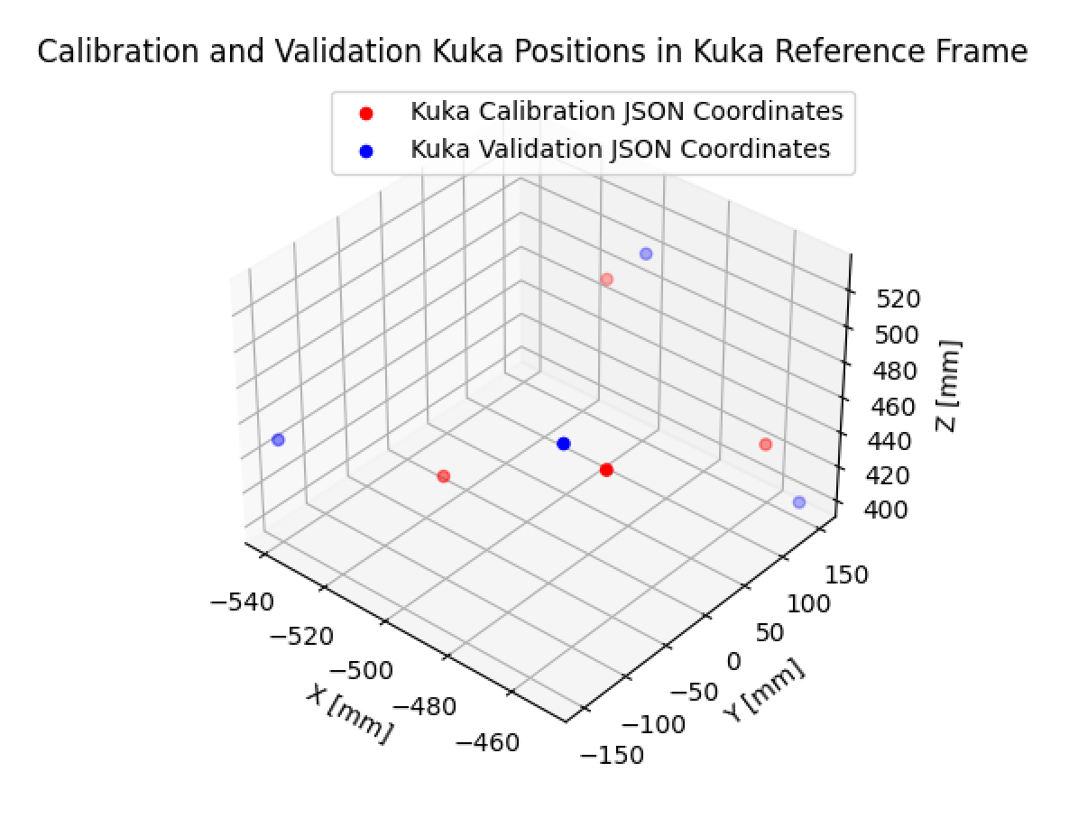
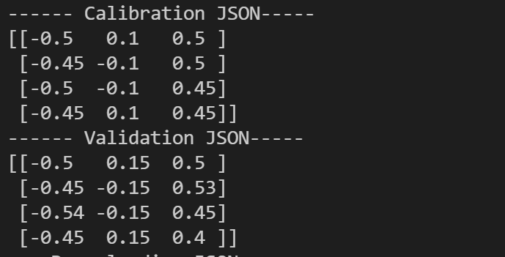
Calibration and Validation JSON
Original JSON FILE data (m)
Plotted in millimeters!

Slide 4
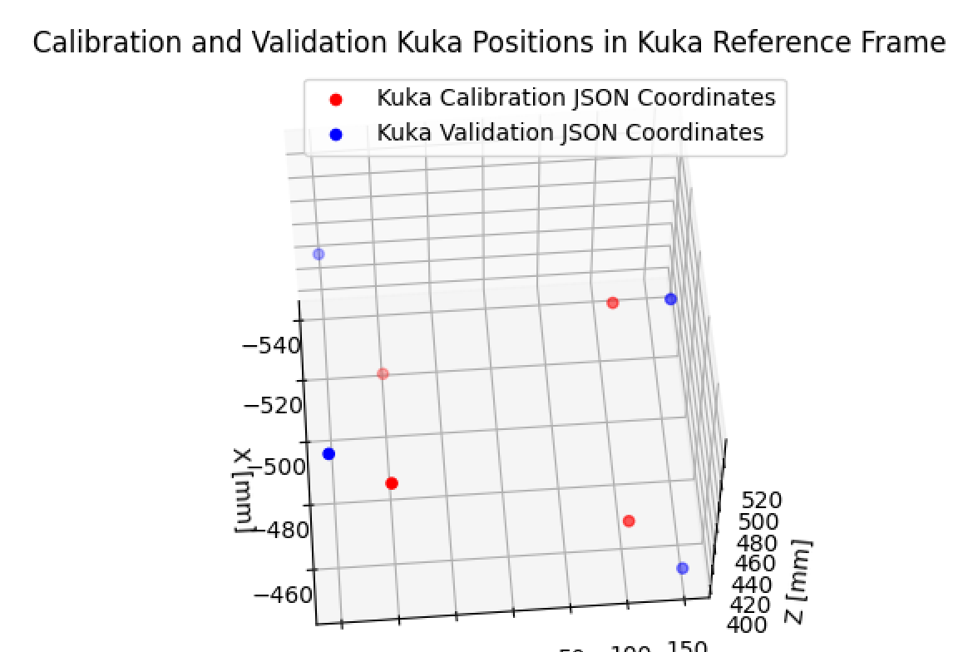
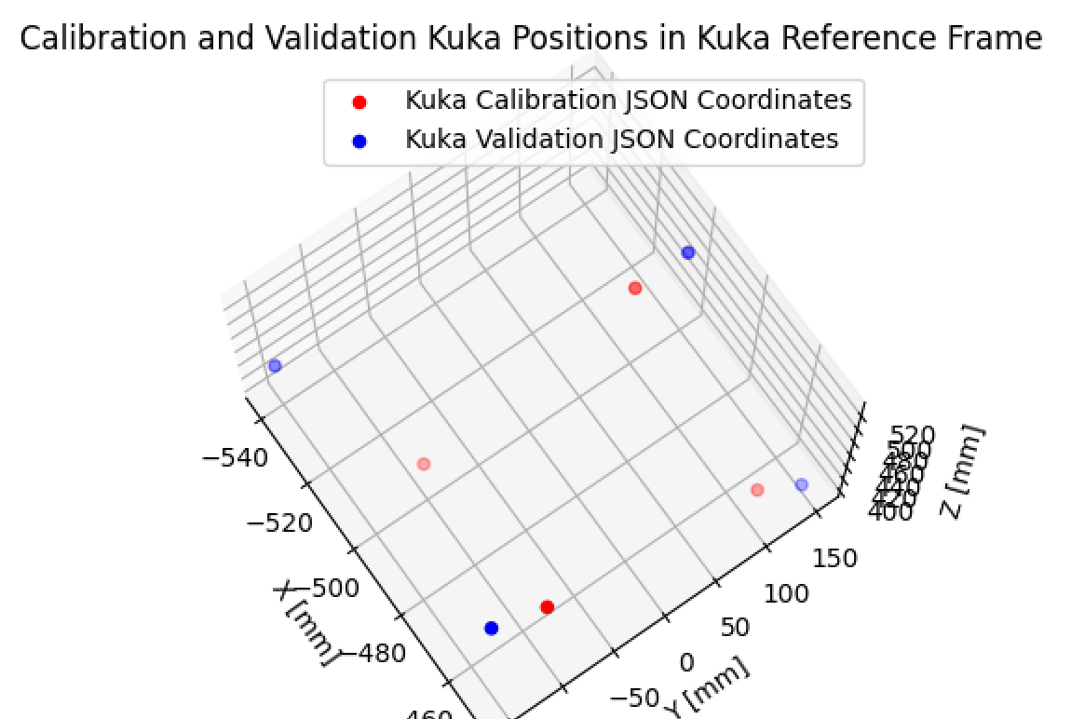

Slide 5
Trajectories
Compare ground truth trajectories (Validation JSON) to the measured aruco ( transformed to kuka reference frame) coordinates.
4 Validation trials were used
Trajectories
0→ 1
1→ 2
2→3

Slide 6
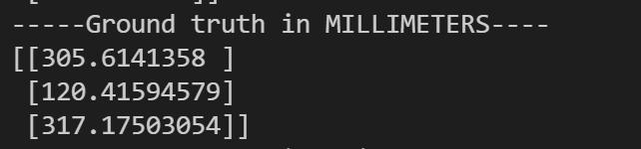
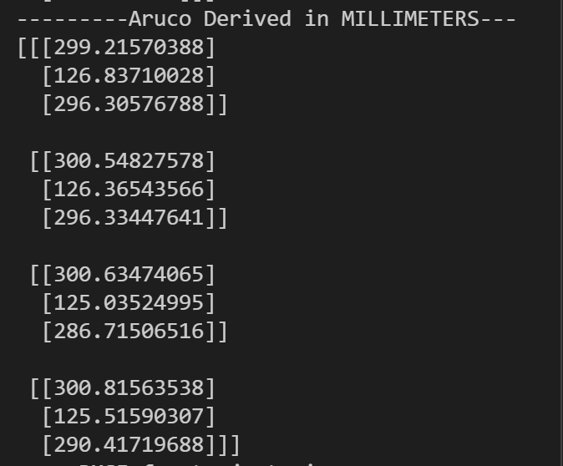
Trajectories

Slide 7
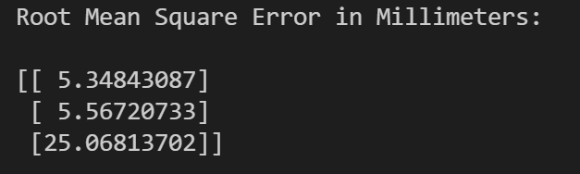
Trajectory RMSE ** all on validation data
High RMS error in Z…. Need to investigate

Slide 8
Look into Positional accuracy

Slide 9
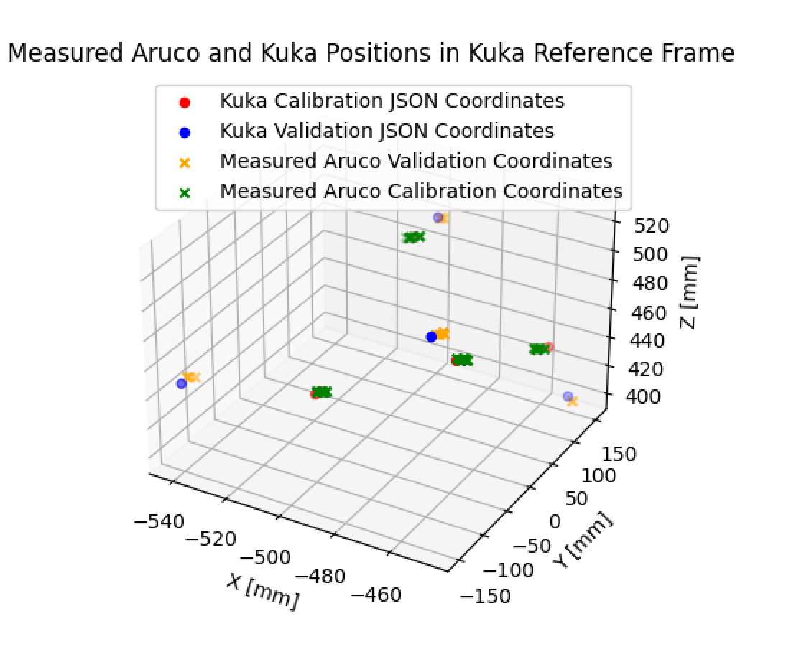
Positions in Kuka reference frame
Note that validation coordinates are outside the volume of the the calibration positions

Slide 10
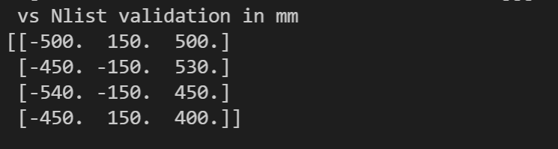
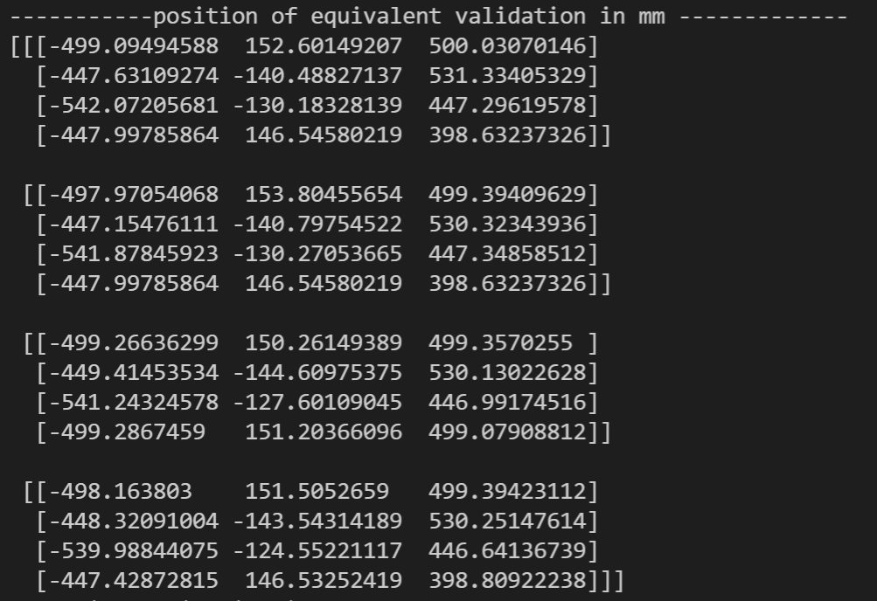
Validation GT vs Aruco Derived Positional Measurements
Use Transformation matrix: aruco→ kuka

Slide 11
Positional RMSE
Point 0
Point 1
Point 2
Point 3
Points 2 and points 3 have the largest RMSE erros

Slide 12
Hypothesis
Larger error may be due to calibration volume does not cover these points

Slide 13

Check RMSE for Aruco measurements used for repeatability study
Recall that in the calibration study we used 5 points from the 29-calibration trial acquisition ( 24 for registration matrix + 5 for quality assessment)
➔ Test hypothesis. If so, we expect better positional accuracy for point within the calibration volume space

Slide 14
See all together:
Using Validation data+JSON data
Using repeatability data + calibration JSON
Takeaways: Positional accuracy is better when points are located within the calibration volume space. Therefore, for future application this would need to be optimized for the working space.

